Slide 1
Chapter 3 part 1
Darcy’s Law for Unsaturated Flow

Slide 2
Negative Pressure

Slide 3
Capillary rise
L= capillary rise
R = radius of the tube
= surface tension of the fluid
= contact angle between fluid and air
The small R, the higher L
Macroscopic forces balance at #1
Downward force = Upward force
A= cross-sectional area of the tube
Capillary pressure
Capillary pressure is conventionally treated as positive

Slide 4
Soil water pressure
Unsaturated soil
Air enter water manometer
Disconnect soil water and the water in the manometer. Cannot be used to measure
pressure in soil.
Fully saturated soil column
Water manometer
Soil water connects with the water in manometer.

Slide 6
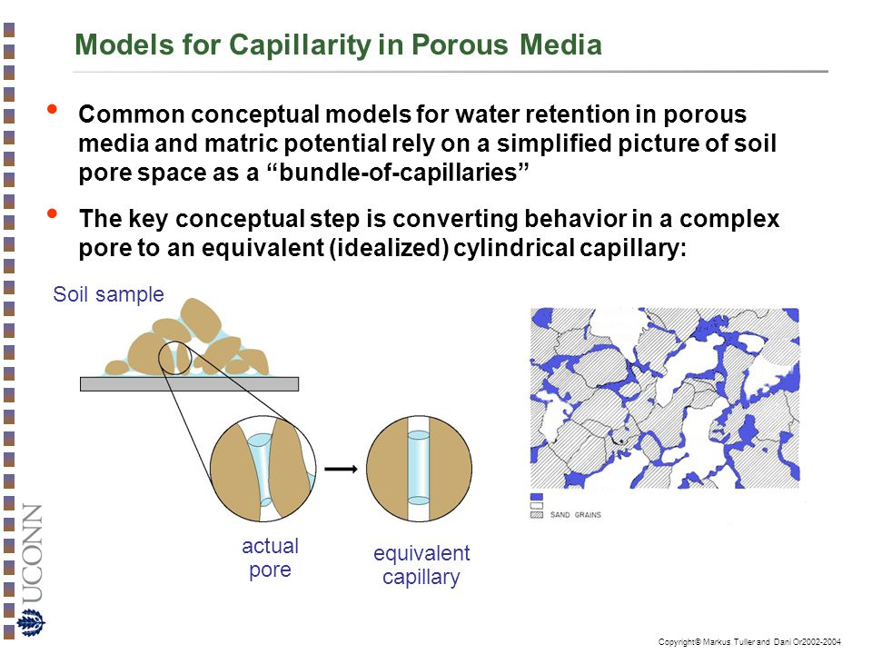

Slide 7
Tensiometer:
A manometer with a ceramic tip.
Ceramic tip or cup has extremely
small pores. When it is saturated,
It has strong capillary pressure that
deters evasion of air into manometer.
When the water table in the column
is at the cup, water level in manometer
at the same level of the water table.
As the water table drops, large pores of soil around the cup drains first.
Capillary pressure in the small pores prevents further drainage and draws
water from the cup and in turn, the water level in the manometer. As a result,
water level in the manometer lowers. The decrease of the water level represents the
capillary pressure or soil water pressure around the cup. The soil water pressure
at the cup beomes lower than the former water table (atmospheric pressure) and thus is
Negative.

Slide 8
Force balance at Point #2
Soil water pressure
Soil water pressure is considered as a negative quantity.
Soil water pressure is the average capillary pressure over
Many pores around the cup (macroscopic quantity).

Slide 9
Nonlinear negative pressure and total head distribution

Slide 10
Unsaturated media: solids, air, and water.

Slide 11
Degree of saturation
Unsaturated, moisture content, and saturation are volume average concept
based on some Control Volume (CV).
Some parts of the CV may be fully saturated and some parts are unsaturated.
It may depend on the size of CV.
Volume average concept.
Ensemble mean properties: Average over many possible spatial distributions
Within the CV.
A moisture content of a soil sample is 0.4. This does not mean the moisture content
everywhere in the sample is 0.4 saturation unless the air and water is “well mixed”
(or Ergodic).

Slide 12
Intuition:
higher capillary pressure, dryer the soil, less water content
Question:
Any relationship between moisture content and capillary pressure?
Soil-water retention or Soil-water release curve

Slide 13
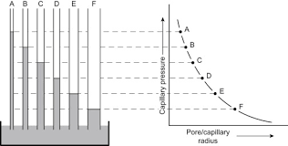

Slide 15
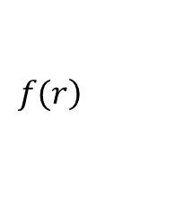
soil water retention curve (SWRC).
Bundle of capillary tubes of different radius analog
$$\left.f(r\right)$$
Frequency distribution of tube sizes
= the total number of tubes.

Slide 16
How to measure SWRC?
Hanging column experiments
Why is the ceramic plate used?

Slide 17
Determine the volume of the sample, V_{T}
Oven dry the soil sample.
Saturated the dry soil with water
Determine the saturated water content ϴ_{s}
What is the pressure head at #1?

Slide 18
Lower the manometer outlet
Determine the total outflow Q after flow ceases
Determine moisture content remain
ϴ(h₁)=ϴs – Q/V_{T} h₁=-5cm (the average head over the sample)
Where is the water drained first?
What is the pressure at #1?

Slide 19
Lower the manometer outlet to -8 cm
Determine the total outflow Q after flow ceases
Determine moisture content remain
ϴ(h₂)=ϴ(h₁) – Q/V_{T} h₂=-13cm (the average head over the sample)
What is the pressure right below the ceramic plate?

Slide 21
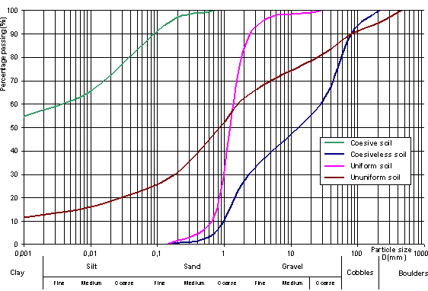
Why? Different water retention curves for different soils

Slide 23
Hysteresis phenomenon
soil water retention curve (SWRC).
Heterogeneity in the CV:
Pore-scale heterogeneity
Entrapped air, raindrop effect , dead end pores, raindrop effect, etc.
Microscopic factors
Artifacts due to volume averaging (Up-scaling).
That is, microscopically, drying process encounters different pore-size distribution than the wetting process

